Slide 1

Mind Over Data
Retail Challenge
GroupAA
Anastasiia Tagiltseva
Doris Macean
Doyun Shin
Emil Ahmadov

Slide 2
Business Objectives
Exploratory data analysis
Quarterly analysis
Top products sold
Market Share
Product co-occurences
Point-of-Sales Clustering​
Product forecasting

Slide 3
PoS Quarterly:
Top Products
Filter Options
PoS
Year
Quarter
Features
Product Ranking
Quarterly Trend
Product Details
High Season
Q1 / Q4
Exception
2019

Slide 4
PoS Quarterly:
Family Market Share
Top Family
9 and 12
Steady Q-to-Q Increase
Highest in Q3, little quarterly fluctuation

Slide 5
PoS Quarterly:
Category Market Share
Category 178

Slide 6
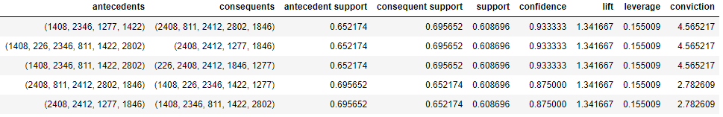
PoS Quarterly:
Product Co-occurrence

Slide 7
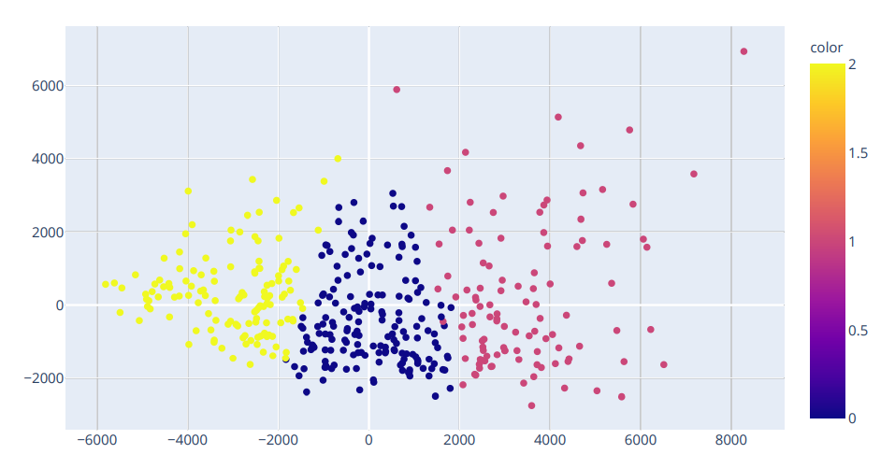


Point-of-Sales Clustering
TOP-10 Product Name ID by clusters
174 shops
Cluster 1 Avg sales 460k
 | Popular Products: 356 993 2609 1277 481 253 1234 847 2802 1147
107 shops
Cluster 2 Avg sales 618k
 | Popular Products: 356 253 993 1369 2609 481 1277 1234 1147 847
128 shops
Cluster 3 Avg sales 403k
 | Popular Products: 356 993 2609 1277 481 2802 1147 1234 847 567

Slide 8
Forecasting
Split Data
01
Train
Test
Apply Different Forecasting Methods
02
ARIMA Models
Exponential Smoothing Models
Holt's Method
Compare
03
Compare forecasts for test period
R square
Future Forecast
04
Do the forecasting for future by using best model

Slide 9
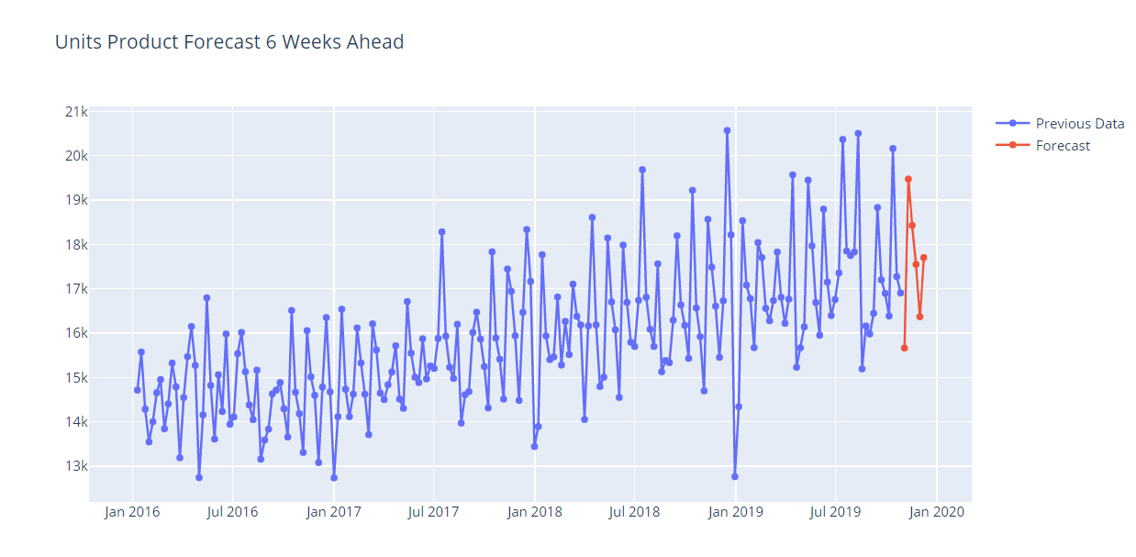
Forecasting for Total Units
Product No: 1277
R-square score: 0.73
For top 5 products average R-squared value of 0.40

Slide 10
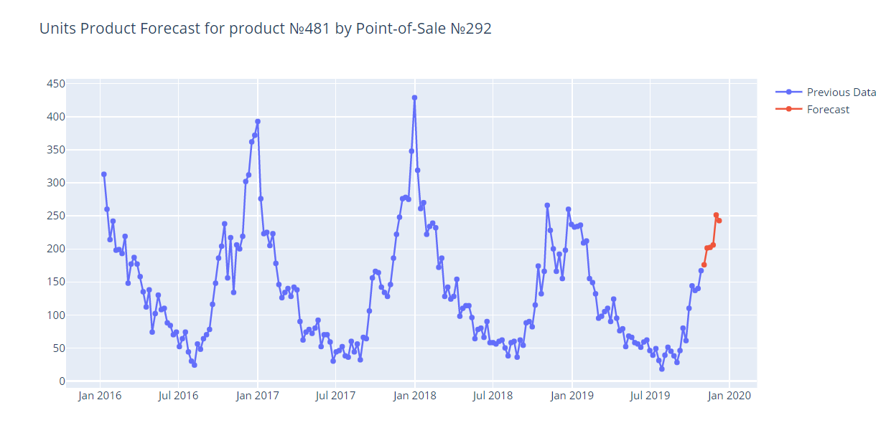
Forecasting for Each PoS
Product No: 481, PoS:292
R-square score: 0.80
For top 5 products in location 292 average R-squared value of 0.50

Slide 11
Mind Over Data
Selected Point-of-Sale:
Selected Products:
150
Top 5
107 PoS
Cluster 2
 | 356 253 993 1369 2609 481 1277 1234 1147 847

Slide 12
Deployment Plan
Pre-deployment Meeting
Virtual Environment Development
Survey, end.
Focus Group Feedback Collection
Analysis of collected data during the pre-deployment stage to decide implementation design
Pilot Program Survey, start
M-4
M-3
M-2
M-1
Post-deployment
Full Deployment, Stage 3
Full Deployment, Stage 2
Full Deployment, Stage 1
Continuous evaluation.
Periodical in-depth evaluation
Target all points of sale
Target Number Expansion
Target random points of sale.
Continuous Evaluation
M+x
M+2
M+1
Month

Slide 13
THANK YOU

